Slide 1
Movement: (Wo)Man and Machine – Part Deux
AMI EAA Summer Conference: July 2017
Greenville, SC
Presented by: Nicole Fedorow-Rehder & Erin Higginbottom

Slide 2
The Engineers of Antiquity

Slide 3
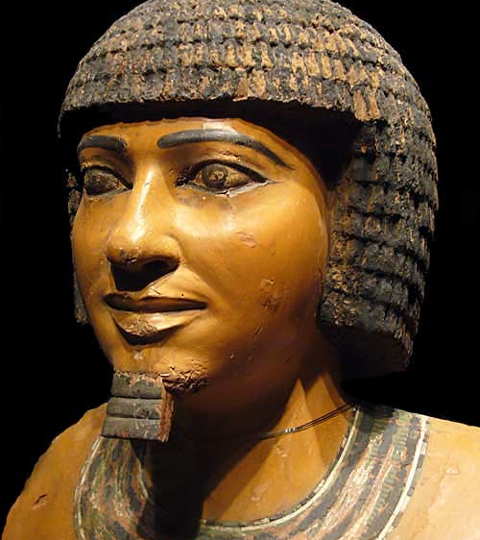
Imhotep
Born 27the century B.C.E.
Architect, philosopher, astrologer, physician and statesmen
God of Medicine

Slide 4
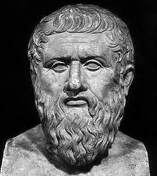
Archytas of Tarentum
428 B.C.E- 347 B.C.E
Greek philosopher/ mathematician
Pythagorean
Invented the first mechanical flying robot bird
Explored screws and pulleys
Founder of mathematical mechanics

Slide 5
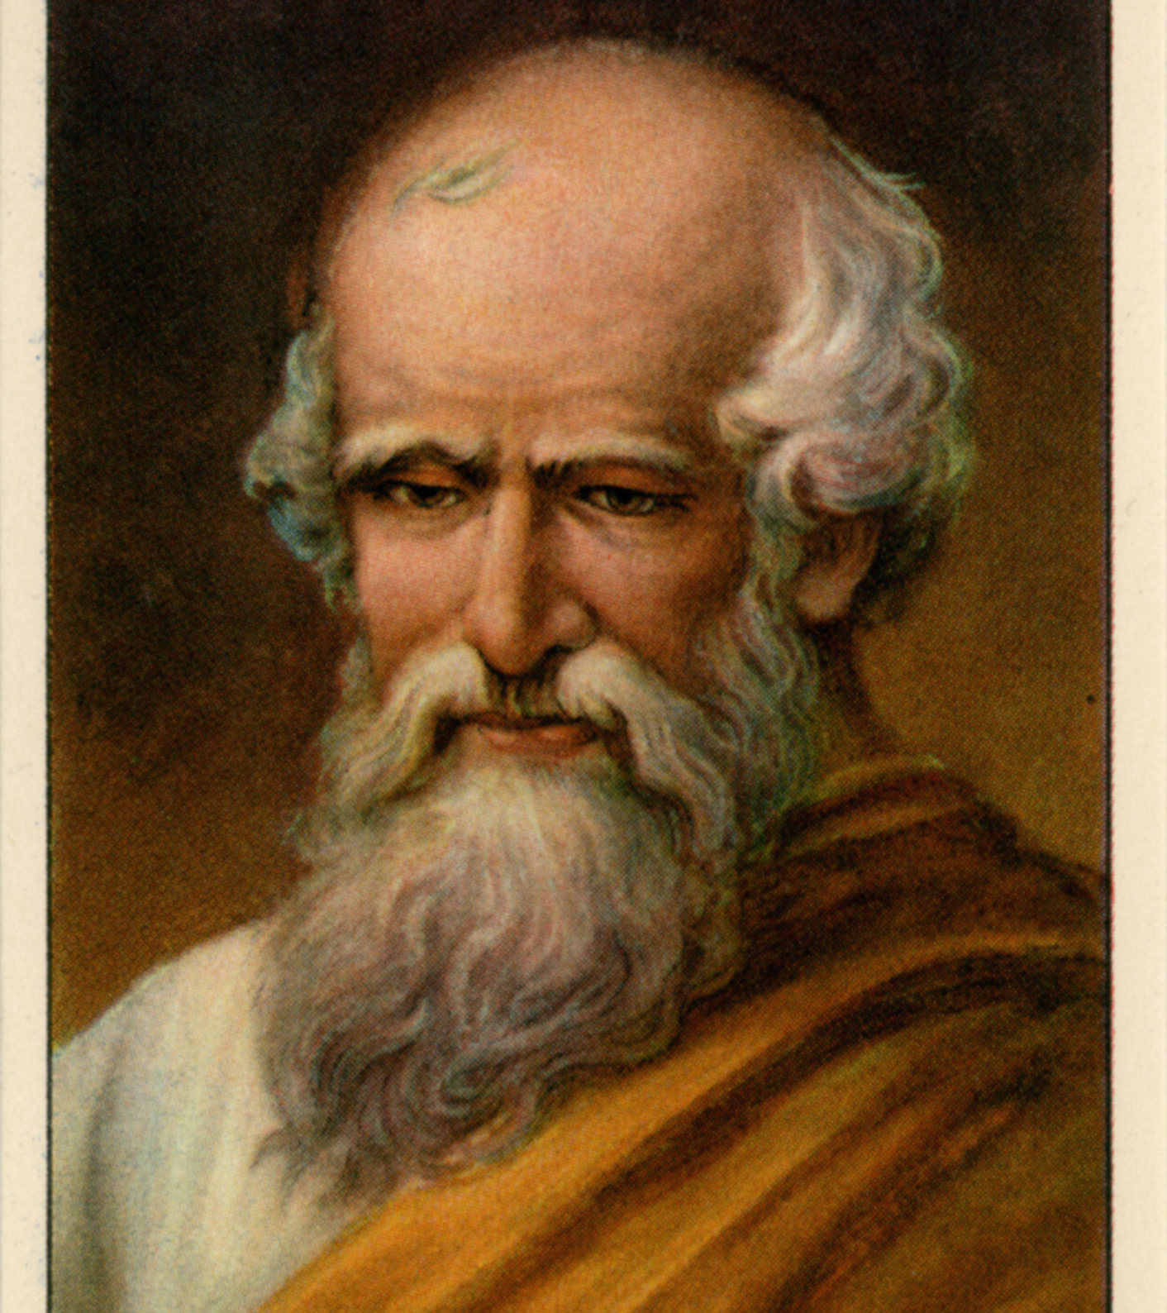
Archimedes
287 B.C.E.- 211 B.C.E.
Greek mathematician, philosopher and inventor
Founder of Hydrostatics
Military Engineer for Syracuse (the Claw or Archimedes)

Slide 6
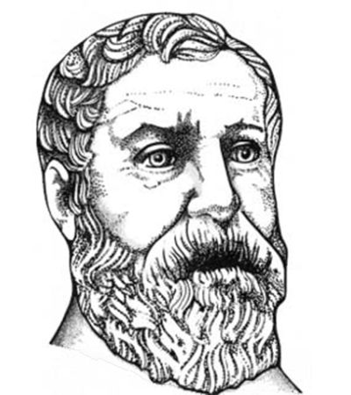
Hero of Alexandria
10-70 C.E.
Roman province of Egypt
Greatest experimenter of antiquity
Windwheel, cuckoo clock and vending machine
Work destroyed in the burring of the Library of Alexandria

Slide 7
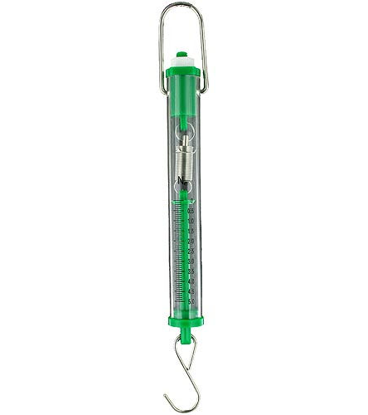
How to use a Spring Scale
Grams measure weight
Newtons are the metric measurement of force
N is the abbreviation for Newton

Slide 8
Debriefing Questions
What worked well (apple)?
What was the biggest challenge/frustration (onion)?
What would you improve upon/change for next time?
Did the right people have the right jobs?
In what ways has this activity improved since last time?
What problems did you encounter, how did you solve them?
What did you like most about this activity?
What was the goal, did you reach it, if so how?
What did you learn, what was your take away?

Slide 9
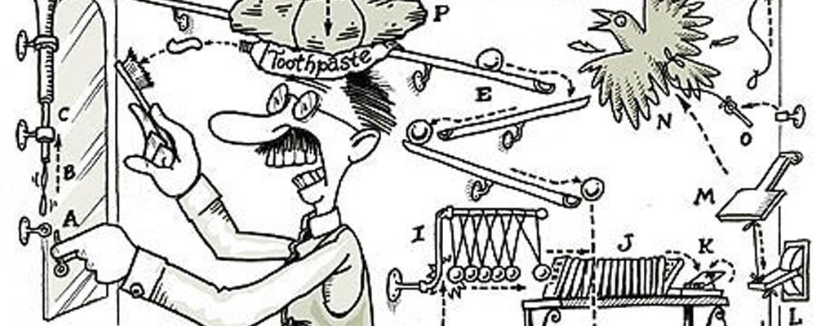
Rube Goldberg
1883 – 1970
Degree in engineering
Simple tasks more challenging

Slide 10
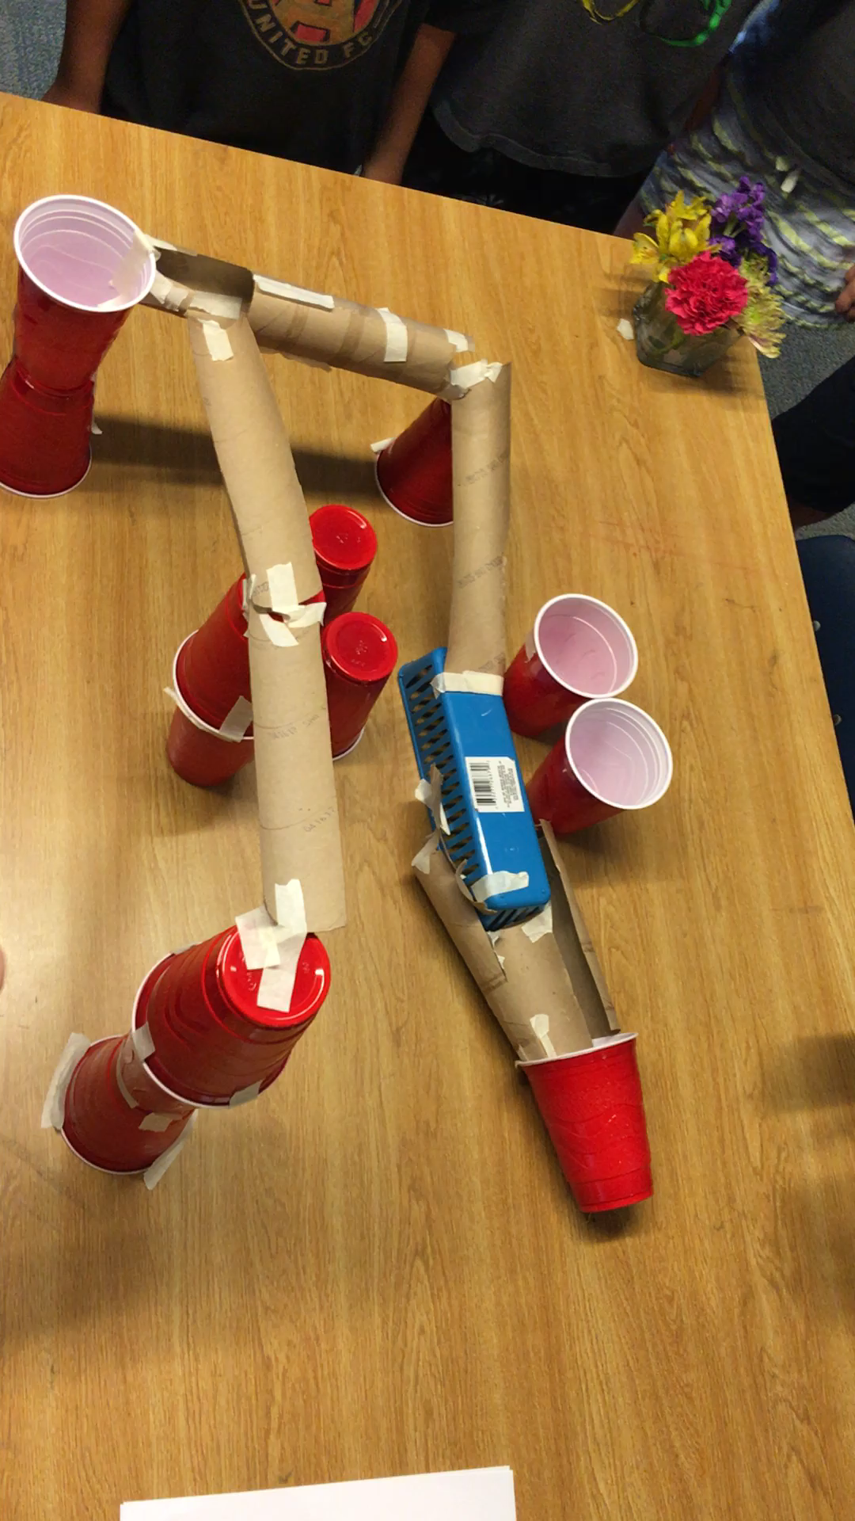
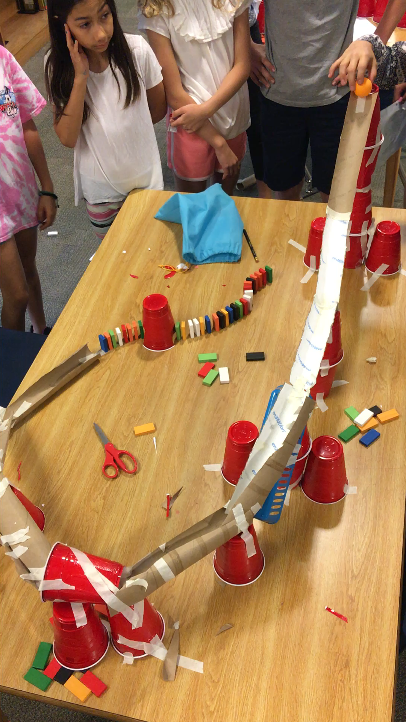

Slide 11
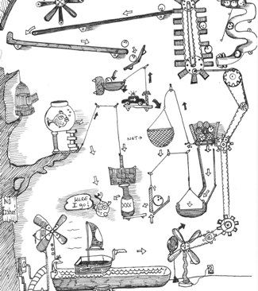
Steps to Writing a Rube Goldberg machine story
Player 1: Write a sentence about the purpose of the machine
Player 2: Write a sentence about how the machine begins
Players 3-5: Write sentence about the different obstacles in the machine.
Last player: Writes the final action of the machine that achieves its purpose.

